Slide 1
Christian Stritzke and Sebastian Lehrig
Graphiti for PCM Editors
Why and how we should use it

Slide 2
Version 1
Version 2
<<Correspondence>>
<<Correspondence>>
Notes:
In Paderborn, we always have different system models for the same system
Show correspondences
We need an editor for that
Editor shows components

Slide 3
<<reuse>>
<<reuse>>
<<reuse>>
<<Correspondence>>
To Do
Already there
<<Correspondence>>
Student Worker

Slide 4
Requirements
Requirement
Reusability (Shapes, behavior, …)
Easy-to-learn (Documentation, tutorials, …)
Comfort functions (Auto-layout, initialization, …)
Requirement | Fulfilled by GMF
Reusability (Shapes, behavior, …)
Easy-to-learn (Documentation, tutorials, …)
Comfort functions (Auto-layout, initialization, …)
Student Worker
Notes:
Reuse figures (Assembly Context, Ports)
Reuse behavior

Slide 5
Reusability: Shapes
GMF Tooling Models
Generated Code
Custom Code
transform
customize
AssemblyContext
Notes:
In Paderborn, we always have different system models for the same system
Show correspondences
We need an editor for that
Editor shows components

Slide 6
Reusability: Behavior
GMF Tooling Models
Generated Code
Custom Code
transform
customize
Instantiate Component
Select from Repository
Draw Assembly Context
Draw Ports
Component
Ass.Context
Ass.Context
Component
Component
Notes:
In Paderborn, we always have different system models for the same system
Show correspondences
We need an editor for that
Editor shows components

Slide 7
Requirements
Requirement | Fulfilled by GMF
Reusability (Shapes, behavior, …)
Easy-to-learn (Documentation, tutorials, …)
Comfort functions (Auto-layout, initialization, …)
Student Worker
Notes:
Reuse figures (Assembly Context, Ports)
Reuse behavior

Slide 8
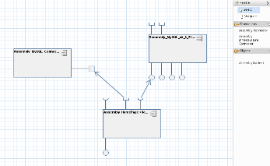
What‘s your beef
with GMF?
How about an alternative?
What about the
requirements?
What have we learned?

Slide 9
Graphiti Architecture
Graphiti
Rendering Engine
Interaction Component
Pictogram Model
Diagram Type Agent
Domain Model
Link Model

Slide 10
Diagram Type Agent
public class ADomainPattern extends AbstractPattern {
public Object[] create(ICreateContext context) {
…
}
public void moveShape(IMoveShapeContext context) {
…
}
…
}
DiagramTypeProvider
FeatureProvider
Domain Object 1
Domain Object n
Domain Object Pattern 1
Domain Object Pattern n
…
…
CustomFeature
CustomFeature
CustomFeature
CustomFeature

Slide 11
What‘s your beef
with GMF?
How about an alternative?
What about the
requirements?
What have we learned?

Slide 12
Requirements
Requirement | Fulfilled by GMF | Fulfilled by Graphiti
Reusability (Shapes, behavior, …)
Easy-to-learn (Documentation, tutorials, …)
Comfort functions (Auto-layout, initialization, …)
Student Worker
Notes:
Reuse figures (Assembly Context, Ports)
Reuse behavior

Slide 13
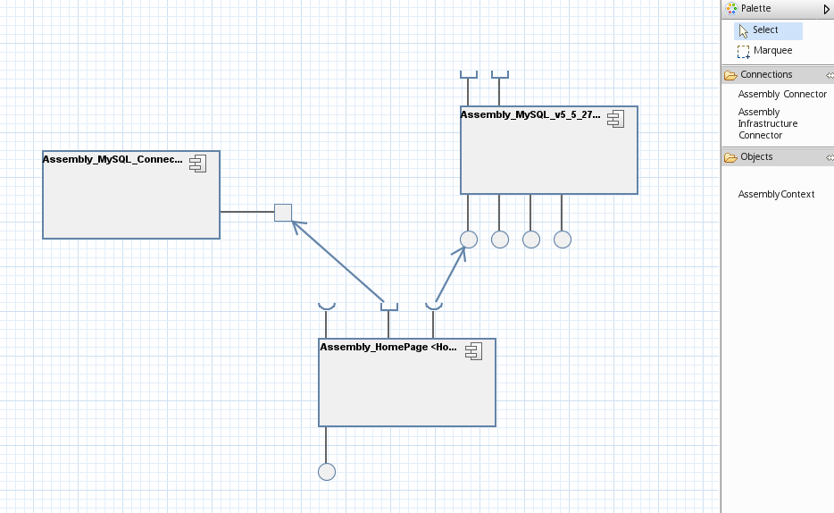
Prototype: Graphiti-Based Composite Structure Editor
AssemblyInfrastructureConnector
AssemblyConnector
AssemblyContext

Slide 14
CompositeStructureFeatureProvider
ConnectorPattern
1
pattern
pattern
1
AssemblyContextPattern
AssemblyConnectorPattern
1
pattern
AssemblyInfrastructureConnectorPattern

Slide 15
DiffViewerFeatureProvider
Correspondence
<<Correspondence>>
1
from
*
to
AssemblyContext
AssemblyContextPattern
CorrespondencePattern
<<Correspondence>>
From Composite Structure Editor
From PCM

Slide 16
Requirements
Requirement | Fulfilled by GMF | Fulfilled by Graphiti
Reusability (Shapes, behavior, …)
Easy-to-learn (Documentation, tutorials, …)
Comfort functions (Auto-layout, initialization, …)
!
Student Worker
Notes:
Reuse figures (Assembly Context, Ports)
Reuse behavior

Slide 17
What‘s your beef
with GMF?
How about an alternative?
What about the
requirements?
What have we learned?

Slide 18
What‘s your beef
with GMF?
How about an alternative?
What about the
requirements?
What have we learned?

Slide 19
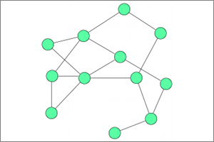
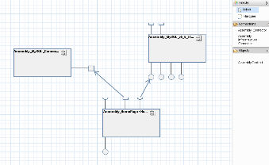
Future Work
Finish the Composite Structure Editor
Apply automatic layouting using Kieler framework
Implement a Diff Viewer for Composite Structures
If things work out well, gradually replace PCM editors

Slide 20
What‘s your beef
with GMF?
How about an alternative?
What about the
requirements?
What have we learned?

Slide 21
TextShape : Shape
graphicsAlgorithm : Text
OperationProvidedRoleShape : Shape
ContainerShape: Shape
graphicsAlgorithm : Ellipse
graphicsAlgorithm : InvisibleRectangle
AssemblyComponent
ProvidedRole
ProvidedRoleConnector : Shape
AssemblyContextShape : Shape
graphicsAlgorithm : Polyline
graphicsAlgorithm : Rectangle

